Slide 1

DML
By, Ms. P.olynia V. Kharbuli
Dept. of Computer Sc.
St. Anthony’s College, Shillong

Slide 2
Contents
SQL Statements
DML Statements
Adding data to table
Inserting NULL values
Using the DEFAULT keyword
Common errors with INSERT
UPDATE Statement
DELETE Statement
Database Transactions

Slide 3
SQL Statements
SQL statements are categorized into five types:
Data retrieval: SELECT
Data Manipulation Language (DML): INSERT, UPDATE, DELETE, MERGE
Transaction Control: COMMIT, ROLLBACK, SAVEPOINT
Data Definition Language (DDL): CREATE, RENAME, ALTER,DROP, TRUNCATE
Data Control Language (DCL): GRANT, REVOKE

Slide 4
DML Statements
Statements used for adding, modifying, or removing data in the database
Privileges are needed for anyone to run DML statements, we must have INSERT, UPDATE, and DELETE privileges.
These privileges are granted automatically if you are the owner of the table
If you are not the owner or a database administrator, you need to be assigned privileges to run the DML statements.

Slide 5
Types of DML Statments
There are three DML statements:
INSERT statement used to add a new row to an existing table.
UPDATE statement used to modify existing rows in a table.
DELETE statement used to remove rows from a table.

Slide 6
Adding data to a table
Syntax:
INSERT INTO table_name [(column1,column2,..,columnN)]
VALUES (value1,value2,…..,valueN);
This statement is crucial as in real-world, the dynamic nature of the data makes addition of rows frequent to Oracle tables
Parameters:
table_name specifies the name of the table where new row is added
Note**- INTO clause always follows the INSERT statement

Slide 7
Column & VALUES Parameter
The COLUMN parameter specifies the column names into which you are inserting values.
Cases
If you omit this parameter, the server assumes that you will provide a value or expression in the VALUES clause for every column in the table.
If you include a column list in your INSERT statement that does not contain all the columns in that table, the Oracle server inserts default value or NULL into the omitted columns.
The VALUES clause specifies the data values to be inserted in the corresponding columns. The values must be specified in the same sequence as the column list in the INSERT INTO clause.

Slide 8
Let us study the Departments and Locations tables given below:
The Departments Table
DepartmentId | DepartmentName | ManagerId | LocationId
10 | Finance | 20 | 10
20 | Accounts | 40 | 20
30 | Labour |  | 30
40 | Stationery | 80 | 10
The Locations Table
LocationId | City
10 | Shillong
20 | Tura
30 | Jowai
40 | Guwahati

Slide 9
Inserting NULL values
There are three different ways to insert a row that has null entries for one or more columns:
Using an empty value in value list
Example:
INSERT INTO departments
VALUES (50, ‘AUDIT’, ‘ ’, 1700);
Using the NULL keyword in the value list
Example:
INSERT INTO departments
VALUES (310, ‘FINANCE’, NULL, 1700);
Omitting the column in the column list as well as its corresponding value in the VALUES clause. Does this method ensure a NULL value is inserted?

Slide 10
Third Step a.k.a Implicit NULL
If you omit a column name from the column list, Oracle server implicitly inserts a NULL value into that column, provided that column can accept a NULL.
If you omit a column that has a NOT NULL constraint, and fail to specify an acceptable value, you receive an error message unless the column has a default value.

Slide 11
Using the DEFAULT keyword
INSERT INTO <table_name>
(column1,column2, column3,…….)
VALUES (value1,value2,DEFAULT,…..);
The DEFAULT keyword is used to insert or update a column with the default values specified for the column.
When you use the default feature while inserting a row, you must not specify a value for the column. The server uses the default value that is associated with the column for the INSERT operation.
When you do not specify a value for a column, the server picks up the default value from where it is stored in the data dictionary.
A NULL value is inserted for columns without a default value.

Slide 12
Inserting Multiple Rows
Unfortunately, an INSERT statement can be used to insert only a single row with a single INSERT statement.
So, if you want to insert five rows, you must use five INSERT statements.
While this might seem to be a major problem, you can create a script file containing a series of INSERT statements. This script can then be brought into SQL*Plus and executed to create all the rows at once.

Slide 13
Integrity Constraint & INSERT statement
Integrity constraints must be taken into account when inserting data.
For example, primary key constraints impose unique constraints on a column so that two rows cannot have the same value in that column.
Also, referential integrity constraints serve a very important purpose. They help ensure the consistency of the data in the database by preventing users from entering an invalid value into a foreign key column.

Slide 14
Common Errors
Misspelled or incorrect column names
Value-Size error (For example, if a column has a data type and length CHAR(5) and if we try to insert a nine-character value)
Invalid Datatype Errors
Mismatched Column-Value Errors

Slide 15
Update Statement
Syntax:
UPDATE tablename
SET column1=value1[,column2=value2,…….]
[WHERE <condition>;]
The table parameter specifies the name of the table whose rows you want to update.
The SET clause specifies the name of the columns that receive new values. Each value in the SET clause specifies the corresponding value for the column which can be a simple value, an expression, or a subquery.
The WHERE clause specifies a condition that identifies the row or rows to be updated. The WHERE clause is optional.

Slide 16
Updating Single Row
In general, use the table’s primary key column to identify a single row.
Using other columns might unexpectedly cause several rows to be updated.
For example: Identifying a single row in the EMPLOYEES table by the FIRST_NAME value is risky because more than one employee may have the same name.

Slide 17
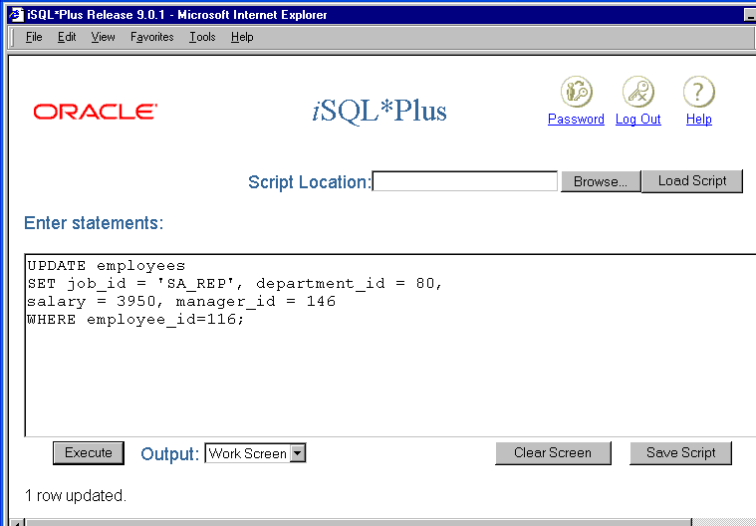

Slide 18
Updating All Rows
If all rows have to updated then simply do not provide the WHERE Clause
For example:
UPDATE employees
SET salary=salary+500;
Here all the rows in the employee tables will have their salary column value increased by 500

Slide 19
Using Multiple Conditions with Update
Sometimes you need to specify multiple logical conditions to limit the impact of an UPDATE statement.
Multiple logical conditions are specified through a single WHERE clause by combining the conditions with the operators AND or OR.
When AND is used, a row must meet both conditions in order to be selected for updating.
When OR is used, a row is selected if either of the conditions surrounding the OR is true.

Slide 20
Example of Multiple Conditions
UPDATE section
SET section_room = ‘RM101’
WHERE course_code = 11
AND instruction_id = 113;
UPDATE section
SET section_room = ‘RM101’
WHERE course_code = 11
OR instruction_id = 113;

Slide 21
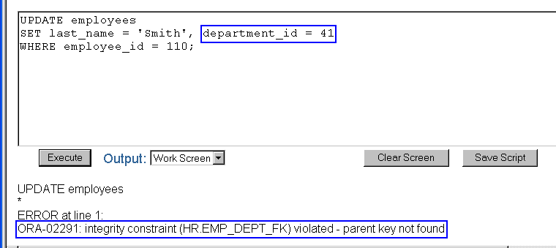
Integrity Constraint & UPDATE
If you attempt to update a record that contains a column that is protected by an integrity constraint, you will receive an error message.
Department 41 does not exist in the DEPARTMENTS table

Slide 22
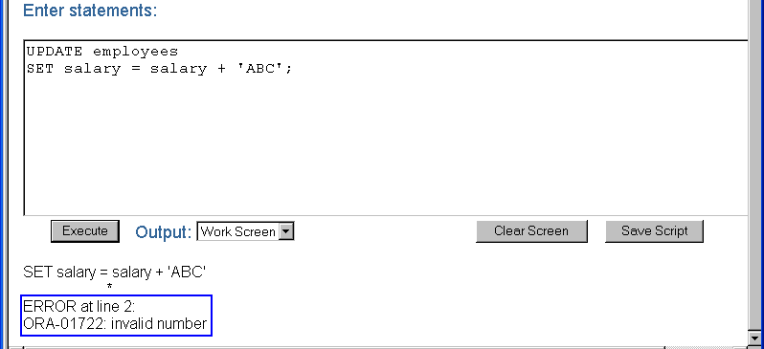
Common Update Errors
As with the INSERT statement, errors such as datatype mismatches, incorrect column names, and value size mismatches will cause problems with the UPDATE statement.

Slide 23
Deleting Rows
DELETE [FROM] table
WHERE <condition>;
The syntax of the DELETE statement is displayed on the screen. In the DELETE statement, the use of the keyword FROM is optional. The FROM keyword is used to improve readability.
The table parameter specifies the name of the table from which the rows are to be deleted.
The WHERE clause specifies the condition that identifies the rows to be deleted. The WHERE clause can accept any SQL condition, including a subquery. If you omit the WHERE clause, all the rows in the table are deleted.

Slide 24
Deleting All Rows
DELETE [FROM] table;
You can delete all the rows in a table by omitting the WHERE clause in the DELETE statement.
When you eliminate all the rows from a table by using the DELETE statement, only the structure of the table remains.

Slide 25
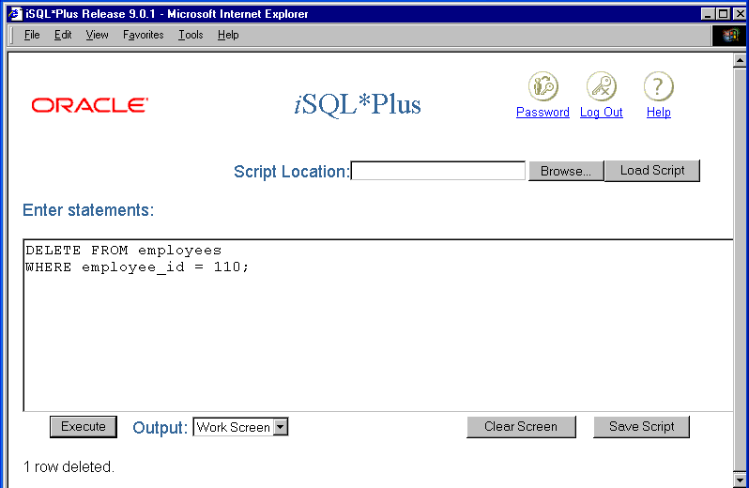

Slide 26
Integrity Constraints & DELETE
When you attempt to delete a row from a table,
the Oracle server verifies if the row is protected by an integrity constraint.
A row is deleted if there are no integrity constraints protecting the row.

Slide 27
Referential Integrity Constraint
Referential integrity constraints can in some cases prevent you from removing a row (or rows) from a table.
If you attempt to delete a row that contains a primary key that is used as a foreign key in another table, the Oracle server returns an error message.

Slide 28
DATABASE
TRANSACTIONS

Slide 29
Contents
Transaction Control Statements
Database Transactions
COMMIT Statement
ROLLBACK Statement

Slide 30
Transaction Control Statements
Transaction – is a collection of related DML statements that forms a unit of work
For example, the INSERT, UPDATE, and DELETE statements are database transactions.
To control the transactions, Oracle SQL provides a set of transaction control statements.
There are three transaction control statements:
COMMIT
SAVEPOINT
ROLLBACK

Slide 31
Database Transactions
A database transaction begins when the first DML SQL statement is executed.
A database transaction ends with one of the following events:
A COMMIT or ROLLBACK statement is used
A DDL or DCL statement executes (automatic commit)
The user exits iSQL*Plus (exits application/tool)
The system crashes

Slide 32
The COMMIT Statement
The COMMIT statement makes all the pending changes in a transaction permanent.
Committing a transaction allows all users to view the results of the transaction.
When a transaction is in progress, the Oracle server locks the affected rows. The locks on these rows are released when the transaction ends. Unlocking those affected rows allows other users on the system to modify those rows.
Finally, committing a transaction erases all savepoints.
Example
UPDATE employees SET job_id = ‘SA_REP’, department_id = 30
WHERE employee_id = 1005;
COMMIT;

Slide 33
The ROLLBACK Statement
You use the ROLLBACK command to discard pending changes and return to an earlier point in the statement sequence.
When you issue a ROLLBACK statement, all the pending data changes are undone. The Oracle server does this by reinstating the previous state of the data blocks, which are retained in a buffer until the transaction ends.
As soon as you run the ROLLBACK statement, the locks on the affected rows are released. Other users can then access the rows. Example
UPDATE employees SET job_id = ‘SA_REP’, department_id = 30
WHERE employee_id = 1005;
ROLLBACK;

Slide 34


